Slide 1

Complex Variable, Laplace & Z- transformation
Lecture 03

Slide 2
This Lecture Covers -
1. Definition of Unit Step Function.
2. Rectangular Pulse.
4. Laplace Transformation of Unit Step Function.
5. Examples & Exercises on Laplace Transformation of Unit Step Function.

Slide 3

Definition of Unit Step Function
The Unit Step or Heaviside’s function is defined as follows:
$$f\left(t\right)=u\left(t\right)=\left\{\begin{aligned}0 ; t<0 \\ 1 ; t≥0\end{aligned}\right.$$
f(t)
1
t
0

Slide 4

Shifted Unit Step Function
The Unit Step or Heaviside’s function is defined as follows:
$$u_{a}\left(t\right)=u\left(t−a\right)=\left\{\begin{aligned}0 ; t<a \\ 1 ; t≥a\end{aligned}\right.$$
f(t)
1
t
a

Slide 5

Rectangular Pulse
A common situation in a circuit is for a voltage v(t), to be applied at a particular time (say $t=a$ ) and removed later at $t=b$ (say). We write such a situation using unit step function as:
$$v\left(t\right)=u\left(t−a\right)−u\left(t−b\right)=\left\{\begin{aligned}1 ;a≤t<b \\ 0 ;otherwise\end{aligned}\right.$$
V(t)
1
t
a
b

Slide 6


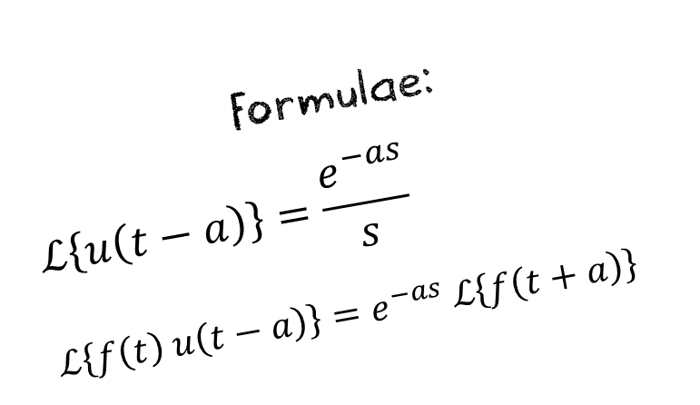
Laplace Transformation of Unit Step Function and Examples
Example 1:
$$ℒ\left\{t^{2} u\left(t−3\right)\right\} \\ =e^{−3s} ℒ\left\{f\left(t+3\right)\right\} \\ =e^{−3s} ℒ\left\{{\left(t+3\right)}^{2}\right\} \\ =e^{−3s} ℒ\left\{t^{2}+6t+9\right\} \\ =e^{−3s} \left[ ℒ\left\{t^{2}\right\}+6 ℒ\left\{t\right\}+ℒ\left\{9\right\}\right]$$ $=e^{−3s} \left[\frac{2!}{s^{3}}+6\frac{1}{s^{2}}+9\frac{1}{s}\right]$.
Ans.
Formulae:
$$ℒ\left\{u\left(t−a\right)\right\}=\frac{e^{−as}}{s}$$
$$ℒ\left\{f\left(t\right) u\left(t−a\right)\right\}=e^{−as} ℒ\left\{f\left(t+a\right)\right\}$$

Slide 7


Laplace Transformation of Unit Step Function and Examples
Example 1:
$$ℒ\left\{\sin{t} u\left(t\right)\right\} \\ =e^{0×s} ℒ\left\{f\left(t\right)\right\} \\ = ℒ\left\{\sin{t}\right\} \\ = \frac{1}{s^{2}+1}$$ Ans.
Example 2:
$$ℒ\left\{e^{−2t} u_{π}\left(t\right)\right\} \\ =ℒ\left\{e^{−2t} u\left(t−π\right)\right\} \\ =e^{−πs} ℒ\left\{f\left(t+π\right)\right\} \\ =e^{−πs} ℒ\left\{e^{−2\left(t+π\right)}\right\} \\ =e^{−πs} \left[ ℒ\left\{e^{−2t} e^{−2π}\right\}\right] \\ =e^{−πs} e^{−2π} ℒ\left\{e^{−2t}\right\} \\ =e^{−π\left(s+2\right)}\frac{1}{s+2}.$$
Ans.

Slide 8



Laplace Transformation of Unit Step Function and Examples
Example 3. Given $f\left(t\right)=\left\{\begin{aligned}8 ;0<t<2 \\ 6 ; t>2\end{aligned}\right.$ , Sketch the function $f\left(t\right)$, also express $f\left(t\right)$ in terms of
Unit step function and hence find it’s Laplace transformation.
F(t)
$$f\left(t\right)=8\left[u\left(t\right)−u\left(t−2\right)\right]+6 u\left(t−2\right) \\ =8 u\left(t\right)−8 u\left(t−2\right)+6 u\left(t−2\right) \\ =8 u\left(t\right) −2 u\left(t−2\right)$$
8
$$F\left(s\right)=8 ℒ\left\{u\left(t\right)\right\}−2 ℒ\left\{u\left(t−2\right)\right\} \\ =8\frac{e^{0×s }}{s} −2\frac{e^{−2s}}{s} \\ =8\frac{1}{s} −2\frac{e^{−2s}}{s}.$$
6
0
2
t

Slide 9
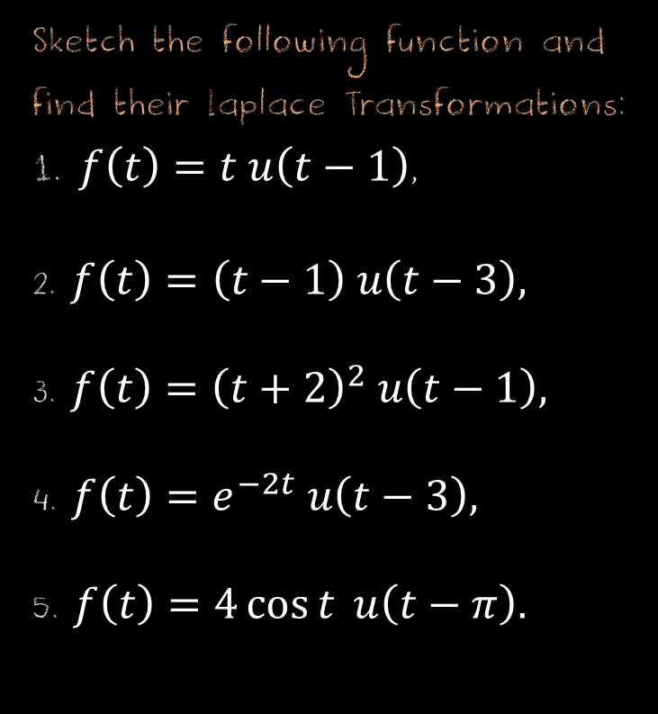

Exercise Set on Laplace Transformation of Unit Step function
Sketch the following function and find their Laplace Transformations:
1. $f\left(t\right)=t u\left(t−1\right)$,
2. $f\left(t\right)=\left(t−1\right) u\left(t−3\right),$
3. $f\left(t\right)={\left(t+2\right)}^{2} u\left(t−1\right),$
4. $f\left(t\right)=e^{−2t} u\left(t−3\right),$
5. $f\left(t\right)=4\cos{t} u\left(t−π\right).$
Sketch the following function, also express $f\left(t\right)$ in
terms of unit step function and find it’s Laplace Transformation:
6. $f\left(t\right)=\left\{\begin{aligned}t ;0<t<1 \\ 2 ; t>1 \end{aligned}\right.$
7. $f\left(t\right)=\left\{\begin{aligned}t^{2} ; 0≤t<1 \\ t−3 ;t≥1\end{aligned}\right.$

Slide 10
Learning Outcomes:
In engineering applications, we frequently encounter functions whose values change abruptly at specified values of time t. One common example is when a voltage is switched on or off in an electrical circuit at a specified value of time t. The switching process can be described mathematically by the function called the Unit Step Function.
In this lecture we overviewed the general concept of unit step function and also discussed the process of Laplace Transformation of unit step function.

Slide 11













Sample MCQ
1. If $f\left(t\right)=\left\{\begin{aligned}1−t ;0<t<1 \\ 0 ; t>1\end{aligned}\right.$ then what is $F\left(s\right)?$
(b)$\frac{s +e^{−s} − 1}{s^{2}}$
(c)$\frac{s −e^{−s} − 1}{s^{2}}$
(d)$\frac{s^{2} +e^{−s} − 1}{s^{2}}$
(a)$\frac{2s+e^{−s} − 1}{s^{2}}$
2. If $V\left(t\right)=\left\{\begin{aligned}0, t<3 \\ 2t+8, 3<t<5 . \\ 0, t>5\end{aligned}\right.$ then which of the following is corresponding unit step function?
(a)$\left(2t+8\right)⋅[u\left(t−3\right)−u\left(t−5\right)]$
(b)$[u\left(t−3\right)−u\left(t−5\right)]$
(c)$[u\left(t+3\right)−u\left(t−5\right)]$
(d)$[u\left(t+3\right)−u\left(t+5\right)]$
3 . $ℒ\left\{t^{2} u\left(t−3\right)\right\}=?$
(a) $e^{−3s}\left[\frac{2}{s^{3}}+\frac{1}{s^{2}}+9\frac{1}{s}\right]$
(b)$e^{−3s}\left[\frac{2}{s^{3}}+6\frac{1}{s^{2}}+9\frac{1}{s}\right]$
(c)$e^{−3s}\left[\frac{2}{s^{3}}+6\frac{1}{s^{2}}+\frac{1}{s}\right]$
(d)$e^{−3s}\left[\frac{1}{s^{3}}+6\frac{1}{s^{2}}+9\frac{1}{s}\right]$

